Slide 1
Task -2 Demo of Java 8 Spring Boot, Data JPA, MySql , CRUD with REST API
Yogita Balpande
27/05/2020

Slide 2
Problem Statement
Use Java 8 features to collate filter the data. Persist the entities using Spring data JPA in Postgresql, Mysql or Mango DB(Any one DB). Also provide ways to select data on the basis of duration of date of birth and other details captured.
Use Java 8 features like functional interfaces, Streams, Optional interface in the applications developed.
Java 8, Spring Data JPA and persist and fetch Data

Slide 3
Tools & Technologies
Developed solution to cater problem need using below technology/Tool
SPRING BOOT - 2.0.4.RELEASE
Spring Framework - 5.0.8 RELEASE
Core JAVA – 1.8
SPRING DATA JPA - 2.0.10.RELEASE
MYSQL - 5.1.47
Logger (log4J)
REST API
Tomcat Sever
POSTMAN client
Apache Maven – 3.2+

Slide 4
Rest API’s
Sr No | HTTP Method | Path | Status Code | Description
1 | GET | /customers/ | 200 (OK) | All Customer Resource Fetched
2 | GET | /customers/{customerId} | 200 (OK) | Specific Customer resource is Fetched
3 | POST | /customers/ | 201 (Created) | A new Customer Resource is Created
4 | PUT | /customers/{customerId} | 200 (OK) | Existing Customer Resource is Updated
5 | DELETE | /customers/{customerId} | 204 (No Content) | Existing Customer Resource is Deleted
6 | GET | /customers/gender{gender} | 200 (OK) | Get All Customer With Gender
7 | GET | /customers/dob/{dateOfBirth} | 200 (OK) | Get All Customer With DateOfBirth

Slide 5
Rest API’s cont..
GET Method
http://localhost:8080/springbootrestapi/customers/search?gender=MALE&dateOfBirth=20-05-2020
Used Request Param
GET Method
http://localhost:8080/springbootrestapi/customers/filterOnCustomerName/{customerName}

Slide 6
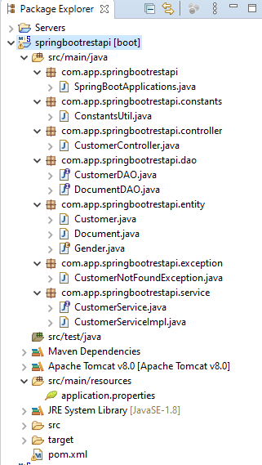
Project Structure
Controller Class
DAO Implementation Classes
Entity Bean
Service Classes
Configuration File
Maven Dependency

Slide 7
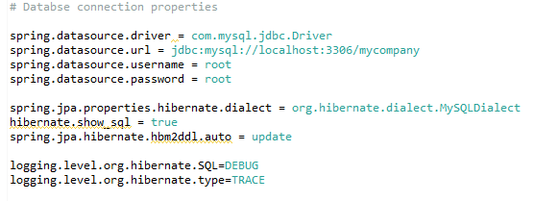
Configuration MySQL Database

Slide 8
Exception Handling
Spring Boot provides a good default implementation for exception handling for RESTful Services.
Resource Not Present
{
"timestamp": "2020-05-25T11:57:14.950+0000",
"status": 404,
"error": "Not Found",
"message": "Invalid Value for Customer : 0",
"path": "/springbootrestapi/customers/"
}

Slide 9
Demo
Demo all API using postman
Source code on github
https://github.com/Ybalpand/SprinBootRESTAPIWithJava8
Suggestions and Feedback
list down all suggestion for improvement and enhancement.

Slide 10
Thank You… & Questions?

